Slide 1
A list of proof systems you are learning
Prove by the truth tables: prop1.ppt
Prove by S/I rules (apply to WFFs directly, but need many rules): prop2.ppt
Prove by resolution (need to convert WFFs to CNF, but need only one rule): prop3/4.ppt

Slide 2
Propositional Resolution
Based on Michael Genesereth Stanford University
Modified by Charles Ling, for CS2209 Use with permission

Slide 3
Propositional Resolution
Propositional resolution is a rule of inference.
Using propositional resolution alone (without other rules of inference), it is possible to build a theorem prover that is sound and complete for all of Propositional Logic.
The search space using propositional resolution is much smaller than for Modus Ponens and the Standard Axiom Schemata.

Slide 4
Clausal Form (Review)
Propositional resolution works only on expressions in clausal form.
Fortunately, it is possible to convert any set of propositional calculus sentences into an equivalent set of sentences in clausal form (same as CNF)

Slide 5
Clausal Form
A literal is either an atomic sentence or a negation of an atomic sentence.
P
~P
A clausal sentence is either a literal or a disjunction of literals.
P
~P
P∨ Q
A clause is a set of literals (same as above).
{P}
{~P}
{P,Q}

Slide 6
Empty Sets
The empty clause {} is unsatisfiable.
Why? It is equivalent to an empty disjunction.

Slide 7
Conversion to Clausal Form (or CNF)
Implications Out:
Negations In:

Slide 8
Conversion to Clausal Form
Distribution
Operators Out

Slide 9
Example

Slide 10
Example

Slide 11
Resolution Principle
General:
Example:

Slide 12
Issues
Collapse
Singletons

Slide 13
Issues
Multiple Conclusions
Single Application Only
Wrong!!
{P, ~P} = T
{Q, ~Q} = T

Slide 14
Special Cases
Modus Ponens Modus Tolens Chaining

Slide 15
Incompleteness?
Propositional Resolution is not generatively complete.
We cannot generate using propositional resolution. There are no premises. Consequently, there are no conclusions.

Slide 16
Answer
This apparent problem disappears if we take the clausal form of the premises (if any) together with the negated goal (also in clausal form), and try to derive the empty clause.
General Method: To determine whether a set Δ of sentences logically entails a sentence ϕ, rewrite Δ {~ϕ} in clausal form and try to derive the empty clause using the resolution rule of inference.

Slide 17
Example
(Prove a wff from empty premise)

Slide 18
Example
If Mary loves Pat, then Mary loves Quincy. If it is Monday, Mary loves Pat or Quincy. Prove that, if it is Monday, then Mary loves Quincy.
P → Q
M → (P v Q)
Prove: M → Q
Convert each premise to clause(s)
Convert the negated goal to clause(s)
Apply resolution, to derive empty clause

Slide 19
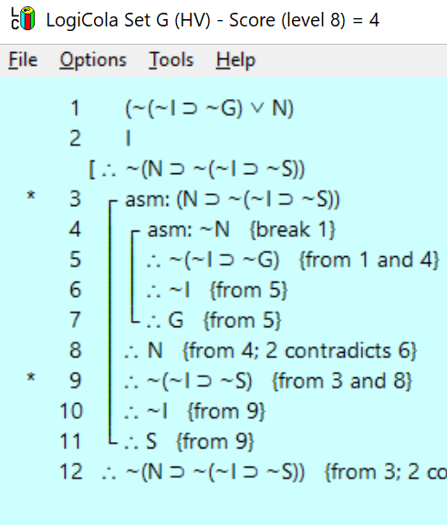
Lets try to do resolution proof
1 = ~(I v ~G v N)
= ~I * G * ~N
= {~I}, {G}, {~N}
2 = I = {I}

Slide 20
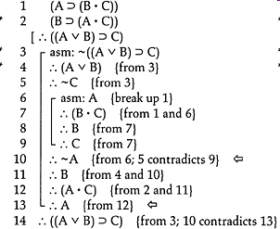

Slide 21
Example
Heads you win. Tails I lose. Show that you always win.
H → Y
T → ~M
Prove Y
How??
Need background knowledge
~H → T
H → ~T
~M → Y
M → ~Y
(Why use logic for real-world common sense reasoning is hard!

Slide 22
Soundness and Completeness
A sentence is provable from a set of sentences by propositional resolution if and only if there is a derivation of the empty clause from the clausal form of Δ {~ϕ}.
Theorem: Propositional Resolution is sound and complete, i.e.
Δ |= ϕ if and only if Δ |- ϕ.

Slide 23
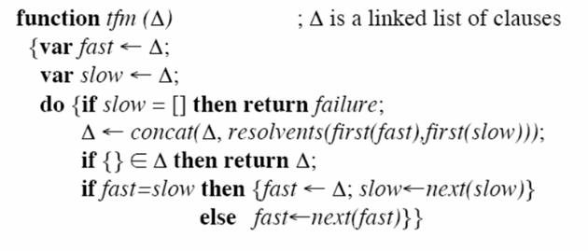
Two Finger Method

Slide 24
Fast, from the very top to slow (reset to top every time when it meets slow)
Slow (slowly move down to bottom, which is expanding)

Slide 25
Two Finger Method

Slide 26
TFM With Identical Clause Elimination

Slide 27
TFM With ICE, Complement Detection

Slide 28
Termination
Theorem: There is a resolution derivation of a conclusion from a set of premises if and only if there is a derivation using the two finger method.
Theorem: Propositional resolution using the two-finger method always terminates.
Proof: There are only finitely many clauses that can be constructed from a finite set of logical constants.

Slide 29
Decidability of Propositional Entailment
Propositional resolution is a decision procedure for Propositional Logic.
Logical entailment for Propositional Logic is decidable.
Sadly, the problem in general is NP-complete.

Slide 30
Horn Clauses and Horn Chains
A Horn clause is a clause containing at most one positive literal.
Example: {R, ~P, ~ Q}
Example: {~ P, ~ Q, ~ R}
Example: ⟨P⟩
Non-Example: {Q, R, ~ P}
NB: Every Horn clause can be written as a “rule”.
{~ P, ~ Q, R} → P Q ⇒ R

Slide 31
Complexity
Good news: When a set of propositional sentences is Horn, satisfiability and, consequently, logical entailment can be decided in time linear in the size of the sentence set.
P Q ⇒ R
R⇒ S
S⇒ T
S ⇒ V
Does {P, Q} |= V?
p
t
r
s
q
v

